Slide 1


Welcome to Social Connect
219110597 TM MAMPA

Slide 2
Table of Contents
Problem Statement
Solution
Screenshots of program

Slide 3
Problem Statement
In the day and age we live in, technology has taken over, people no longer make friends the traditional way. Friends are made via social media, which means some people never get to meet their actual friends. In this instance the problem is creating a social circle.

Slide 4
Solution
The solution to this problem is Social Connect. Social Connect allows a person to make friends by checking any nearby friends with the same hobbies.
Social Connect uses the BFS algorithm in order to find the nearby friends with the same hobbies

Slide 5
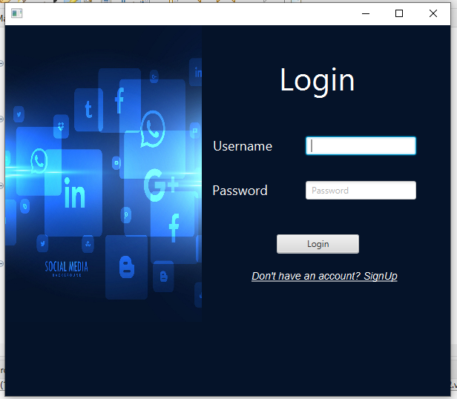
Screenshots
This is the login page where existing users can enter their details to login

Slide 6
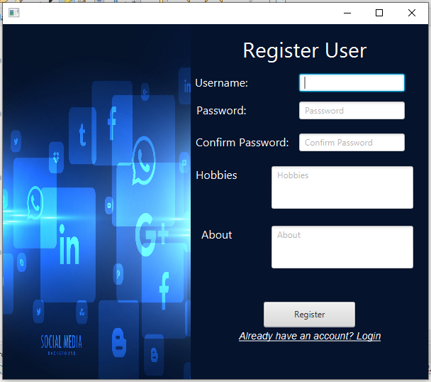
Screenshots
This is the Register page where new users can register before they can login to access the portal

Slide 7
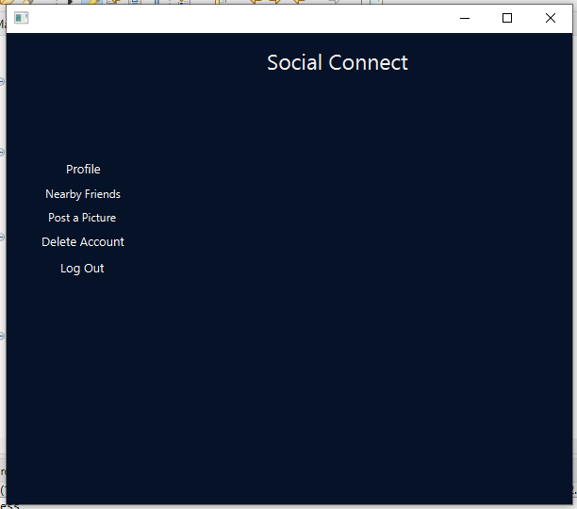
Screenshots
This is the Main menu where the user can post a picture and view it, while also having the navigation bar.
Navigation bar consists of Profile, Nearby Friends, Post a Picture, Delete Account and Log Out

Slide 8
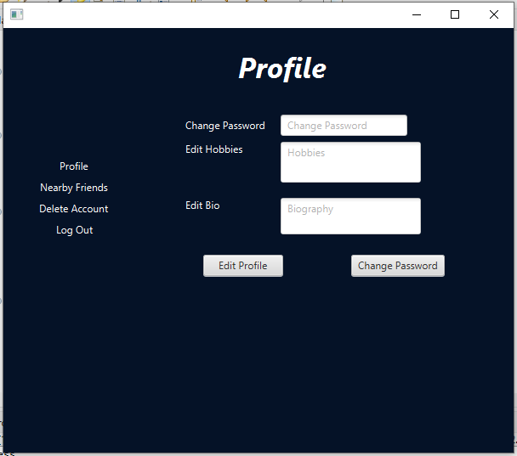
Screenshots
This is the Edit Profile page where the user can edit their profile and change passwords.
Navigation bar consists of Profile, Nearby Friends, Delete Account and Log Out

Slide 9
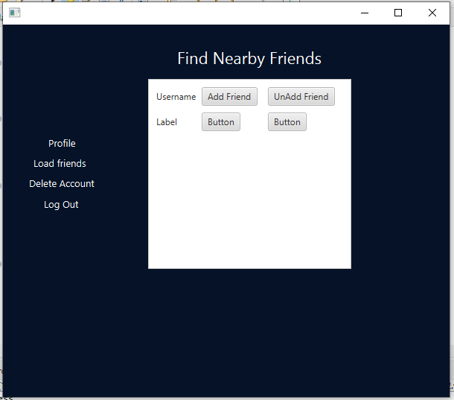
Screenshots
And lastly this the Nearby Friends page where the user can see which friends are nearby that have the same hobbies
Navigation bar consists of Profile, Load Friends, Delete Account and Log Out

